Slide 1
Numerical Methods for Partial Differential Equations
Unsteady and incompresible Navier-Stokes problem
Micucci Francesco
Miani Giorgio
Pasquini Pietro

Slide 2
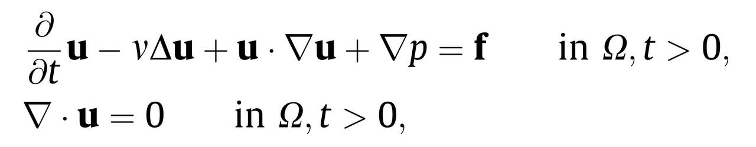
Strong Formulation

Slide 3
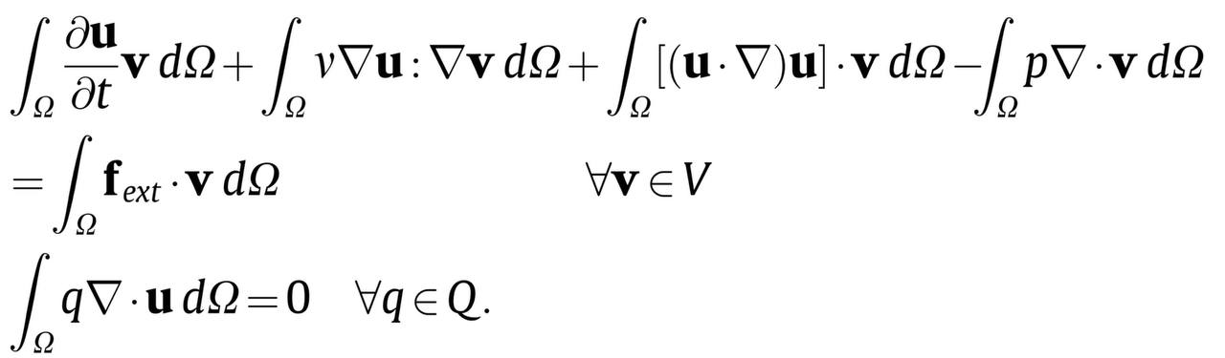
Semi-Discrete Weak Formulation
We introdue two spaces
we introduce two test functions v ∈ V and q ∈ Q, we multiply on both sides and using partial integration we obtain the following formulation

Slide 4
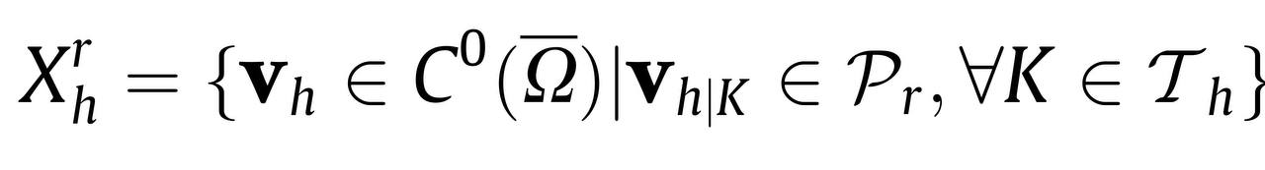
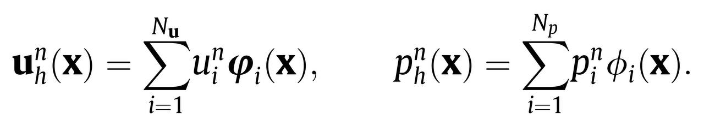
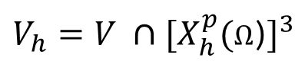
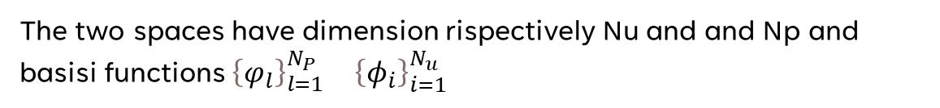
Galerkin Finite Element Formulation
We introdue two finite element spaces
$V_{h}=V ∩{[X}_{h}^{p}(\text{Ω}$)$]^{3}$
$$Q_{h}=Q ∩X_{h}^{q}(\text{Ω}\text{)}$$
Where in general:
The two spaces have dimension rispectively Nu and and Np and basisi functions ${{\left\{φ_{l}\right\}}_{l=1}^{N_{P}}}_{}$ ${{\left\{φ_{i}\right\}}_{i=1}^{N_{u}}}_{}$

Slide 5
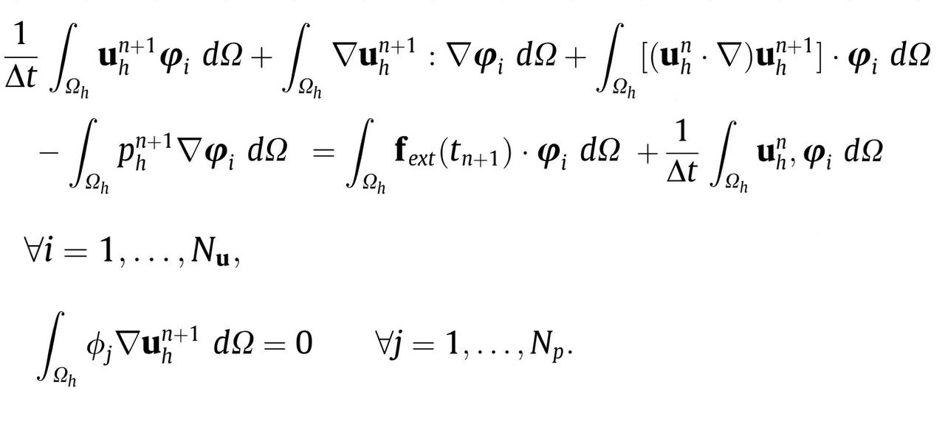
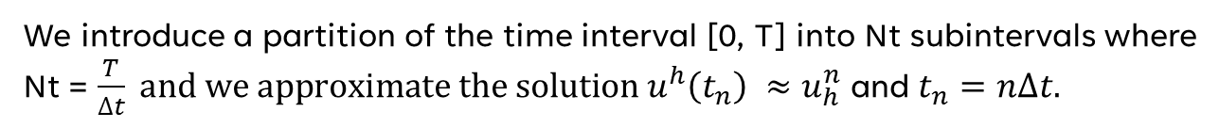
FULLY DISCRETE FORMULATION
We introduce a partition of the time interval [0, T] into Nt subintervals where Nt = $\frac{T}{∆t} and we approximate the solution {u^{h}\left(t_{n}\right) ≈u}_{h}^{n}$ and $t_{n}=n∆t.$

Slide 6
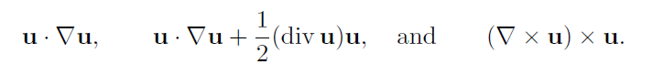
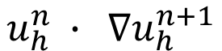
Linearization
CONVECTIVE FORM
SKREW SYMMETRIC FORM
ROTATION FORM
SEMI-IMPLICIT
$$u_{h}^{n} ∙ ∇u_{h}^{n+1}$$

Slide 7
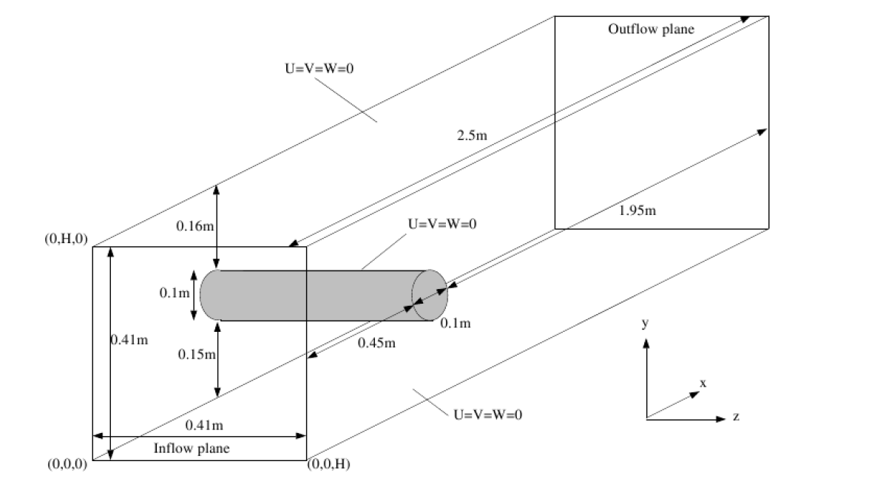
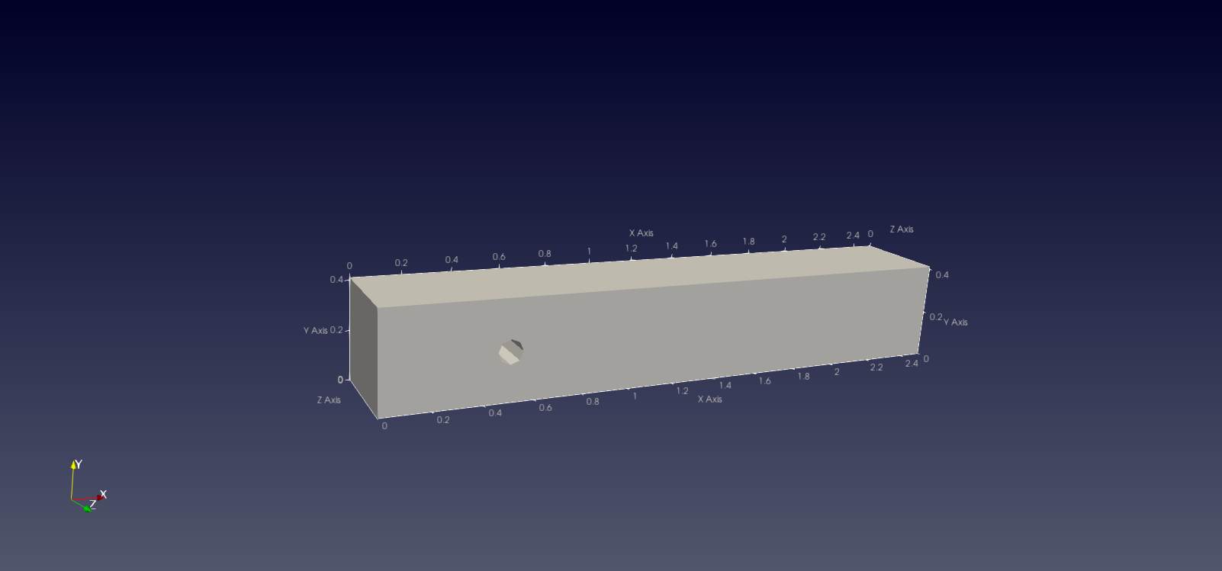
Domain and meshes

Slide 8
Boundary conditions
$$u∙n=0 on {\text{Γ}}_{wall}$$
$\left(μ∇u ∙n −pn\right)∙t=0$ $on {\text{Γ}}_{wall}$
$$u=0 on {\text{Γ}}_{c}$$
$$u=U_{INLET} on {\text{Γ}}_{IN}$$

Slide 9
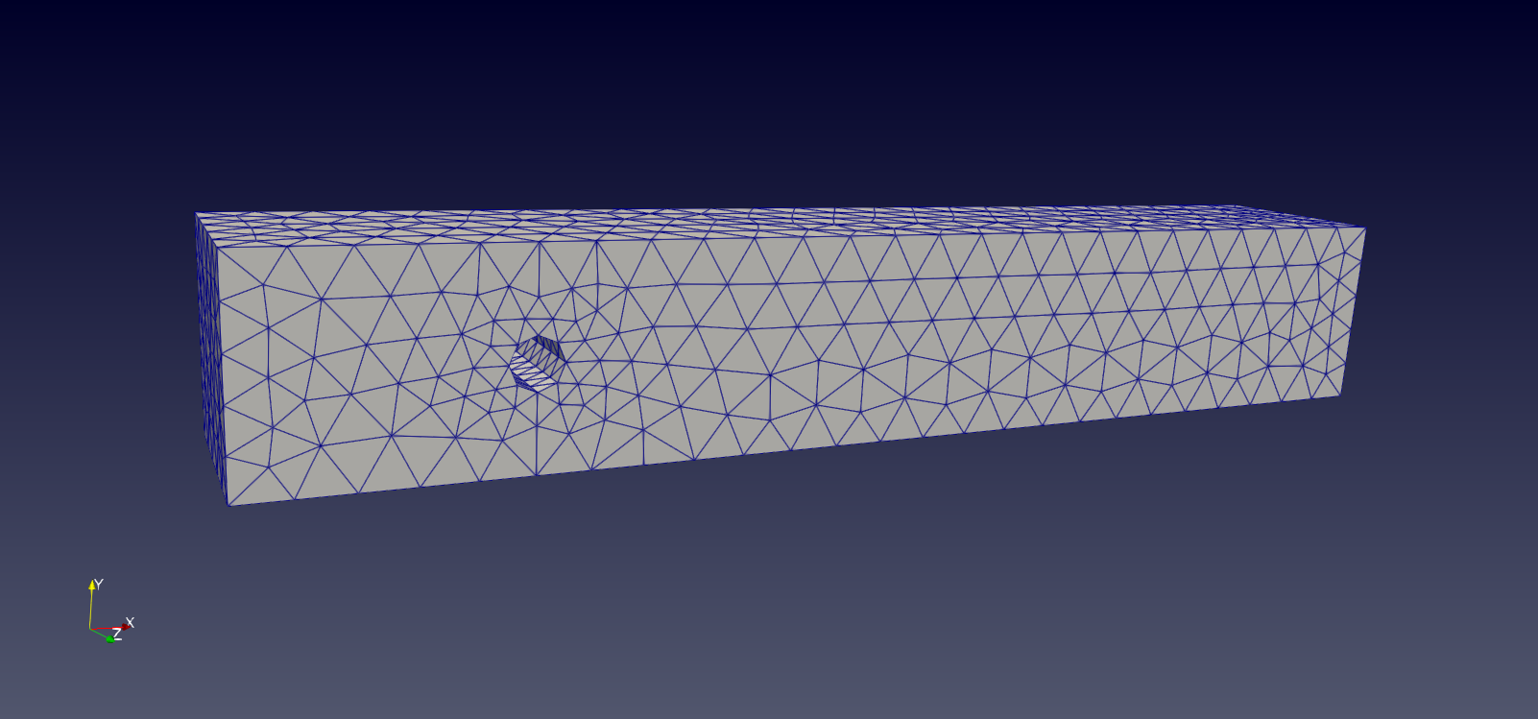
We created 3 differente meshes using different discretization of the domain
h = 0.1;
# elem = 3044
Dof = 17633
h = 0.05;
# elem = 16156
Dof = 82370
h = 0.025
# elem = 117614
Dof = 542600

Slide 10
h = 0.025
# elem = 117614
Dof = 542600

Slide 11
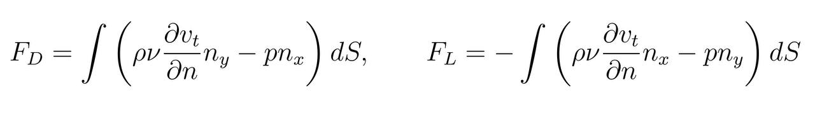
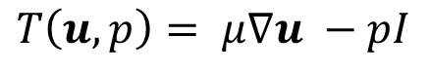
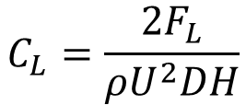
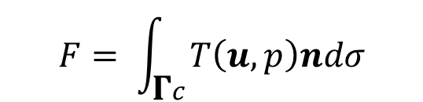
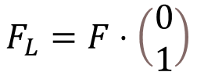
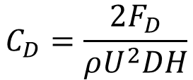
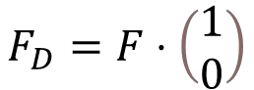
Drag and lift coefficIents
$$C_{L}=\frac{2F_{L}}{ρU^{2}DH}$$
$$C_{D}=\frac{2F_{D}}{ρU^{2}DH}$$
$$F_{D}=F⋅\left(\begin{matrix}1 \\ 0\end{matrix}\right)$$
$$F= \int_{\text{Γ}c}{T\left(u, p\right)ndσ}$$
$$F_{L}=F⋅\left(\begin{matrix}0 \\ 1\end{matrix}\right)$$
$$T\left(u, p\right)= μ∇u −pI$$

Slide 12
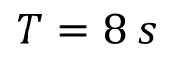
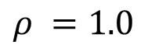
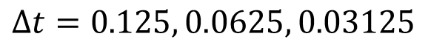
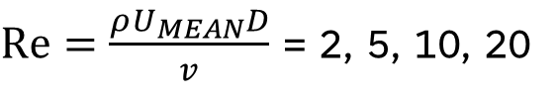
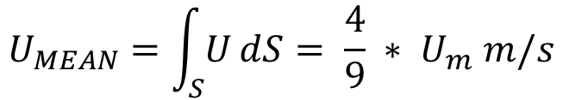
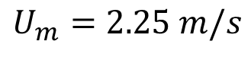
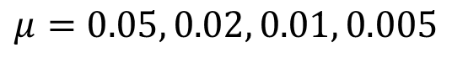
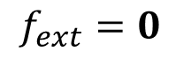
Parameters
$$μ=0.05, 0.02, 0.01, 0.005$$
$$ρ =1.0$$
$Re=\frac{ρU_{MEAN}D}{v}$ = 2, 5, 10, 20
$$U_{m}=2.25 m/s$$
$$U_{MEAN}=\int_{S}{U}dS= \frac{4}{9} ∗ U_{m} m/s$$
$$T=8 s$$
$$∆t=0.125, 0.0625, 0.03125$$
$$f_{ext}=0$$

Slide 13
RESULTS

Slide 14
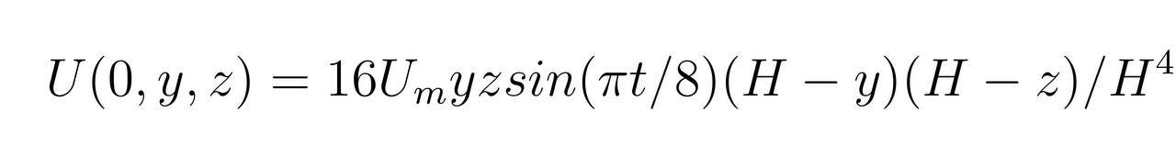
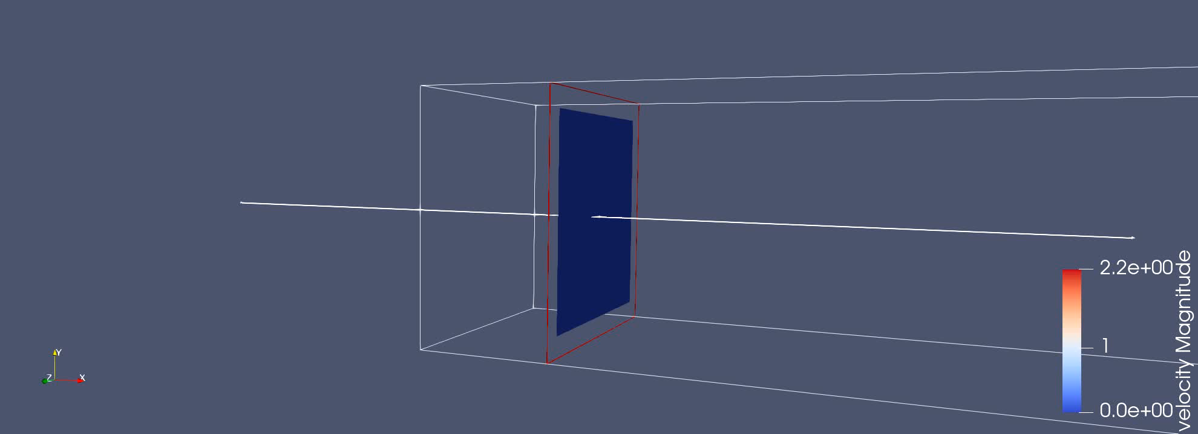
Sinusoidal inlet velocity

Slide 15
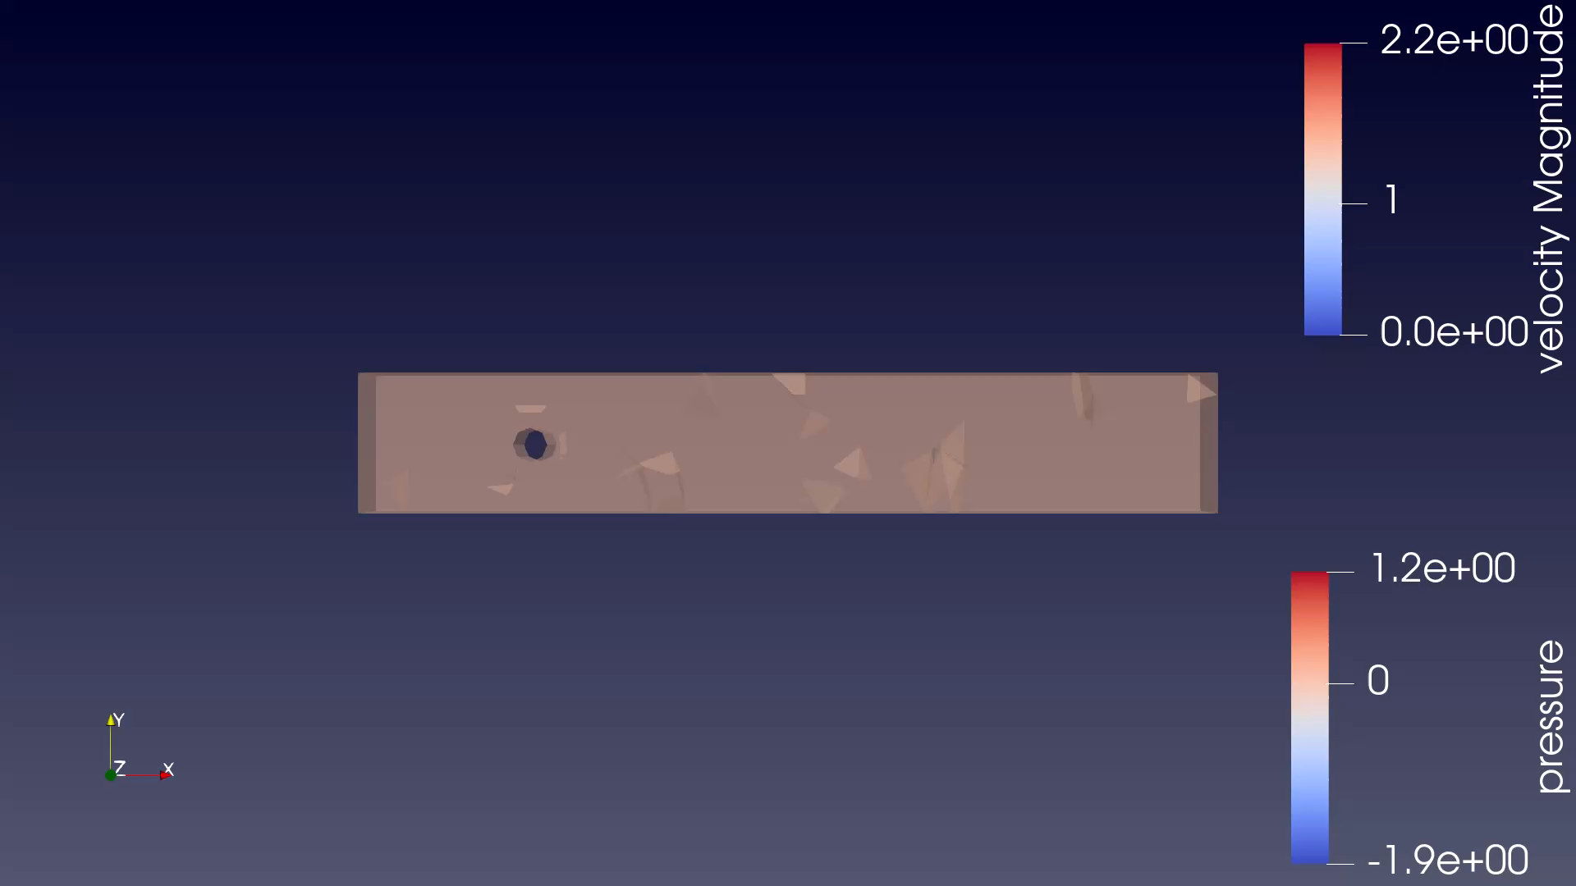
VELOCITY AND PRESSURE(h= 0.1, dt = 0.125, Re = 20)

Slide 16
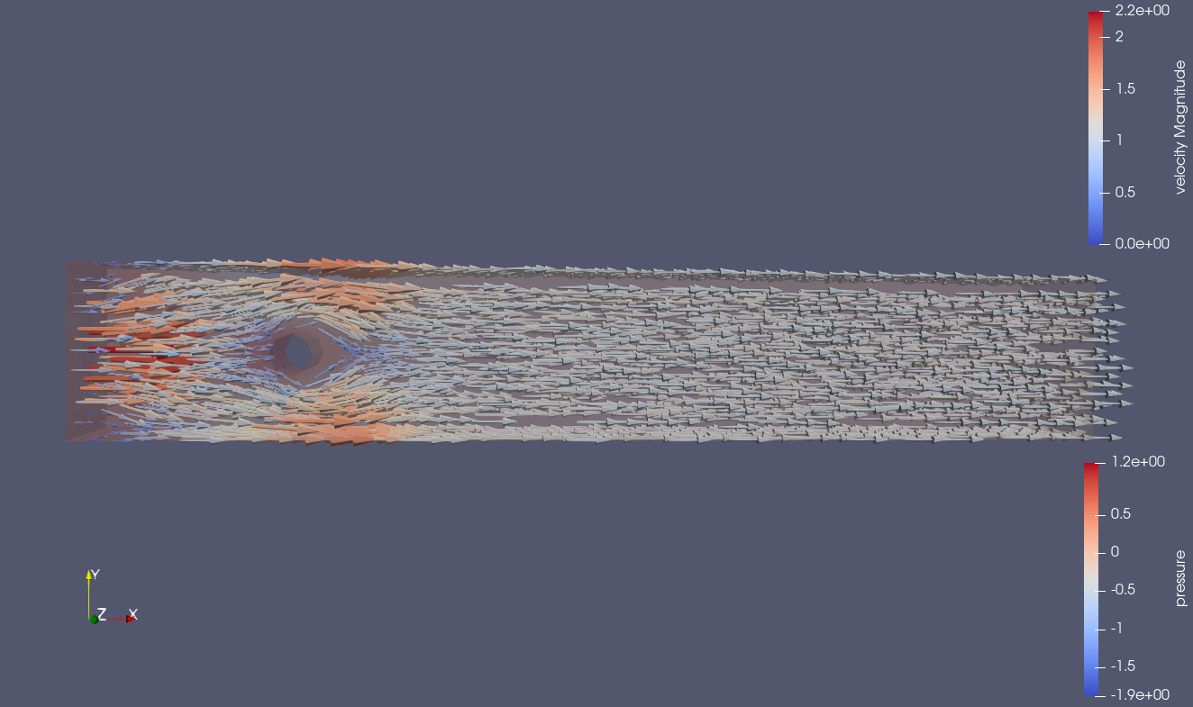
VELOCITY AND PRESSURE(h= 0.05, dt = 0.125, Re = 20)

Slide 17
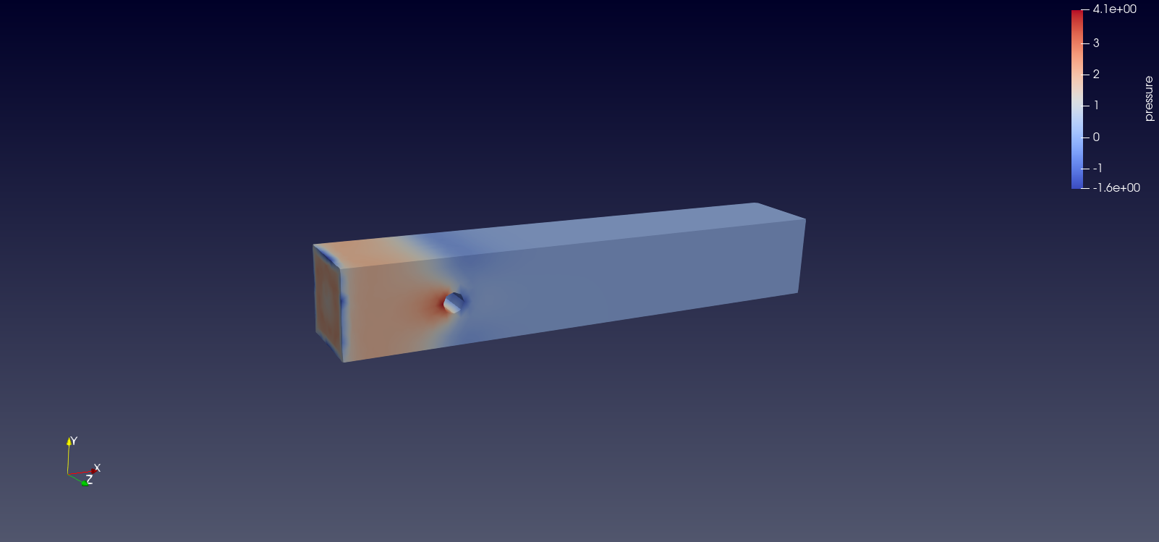
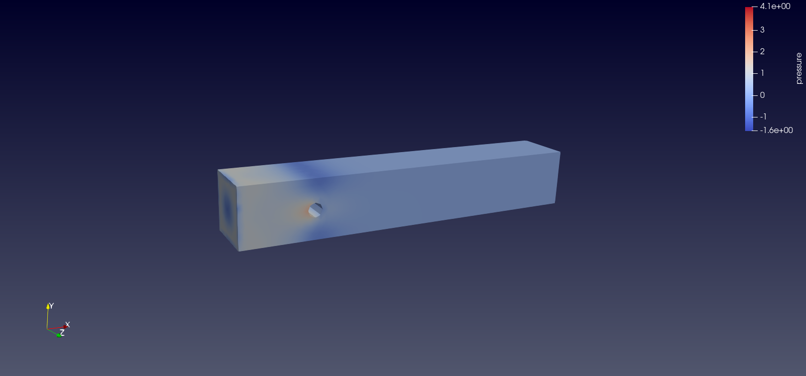
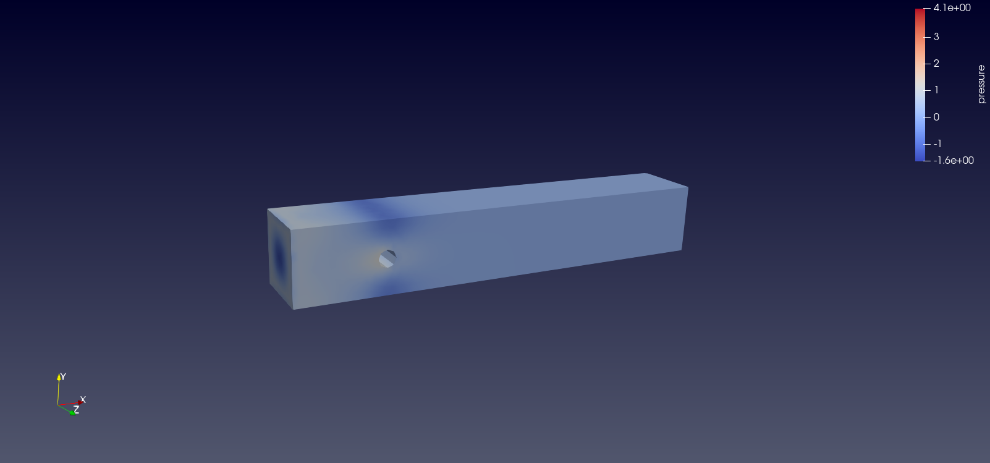
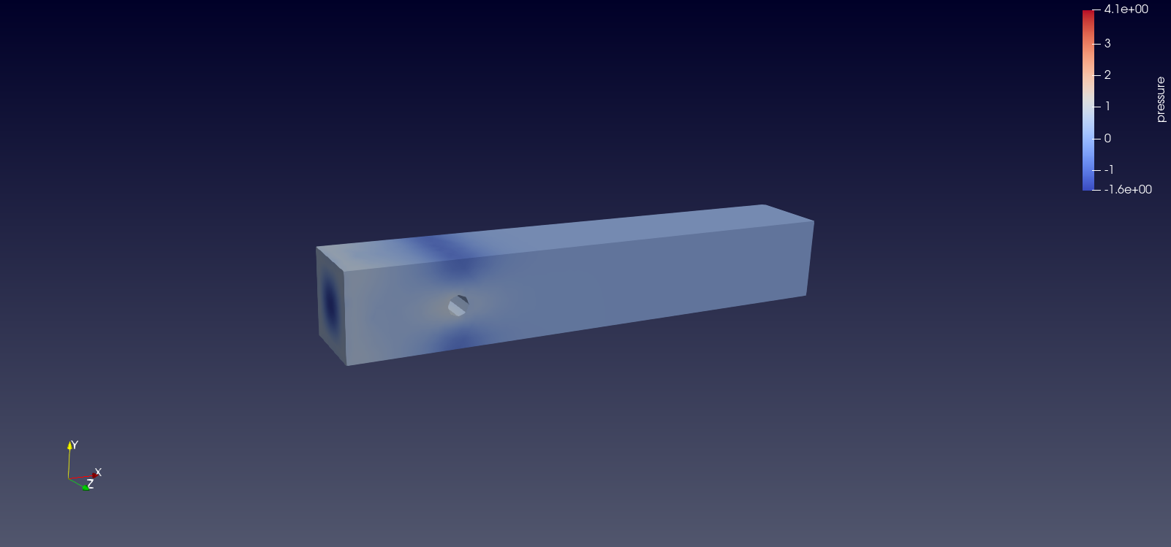
PRESSURE (h = 0.05, dt = 0.125, t=4.0)
Re = 2
Re = 5
Re = 10
Re = 20

Slide 18
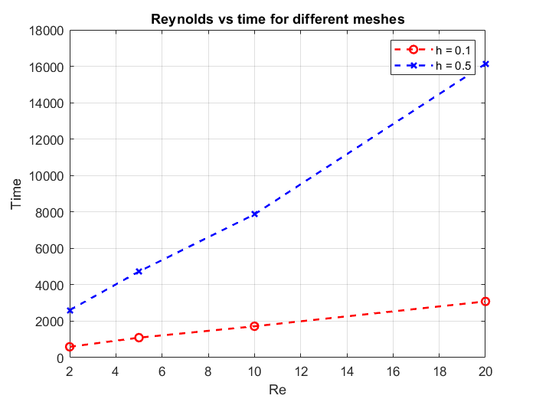
Time vs Reynolds for different meshes($∆t$ = 0.125)

Slide 19
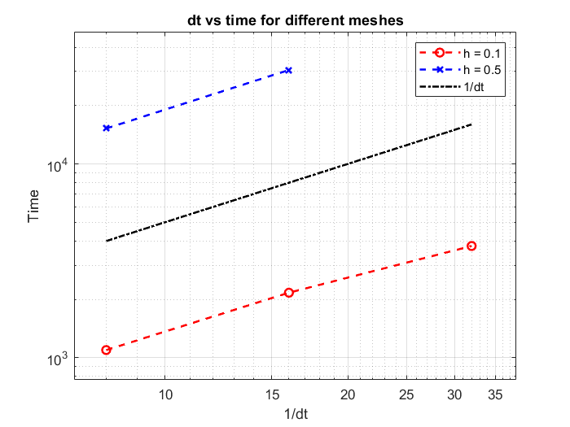
Time vs $∆t$for different meshes on PC (Re =5)

Slide 20
Time PC vs time cluster

Slide 21
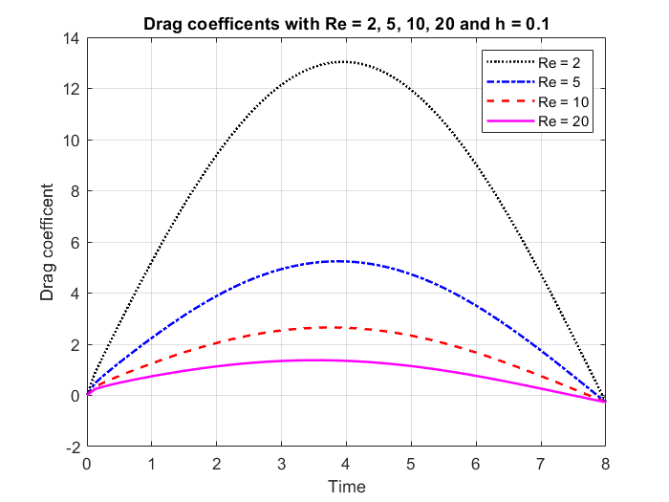

DRAG AND LIFT COMPARISON (dt = 0.125)

Slide 22
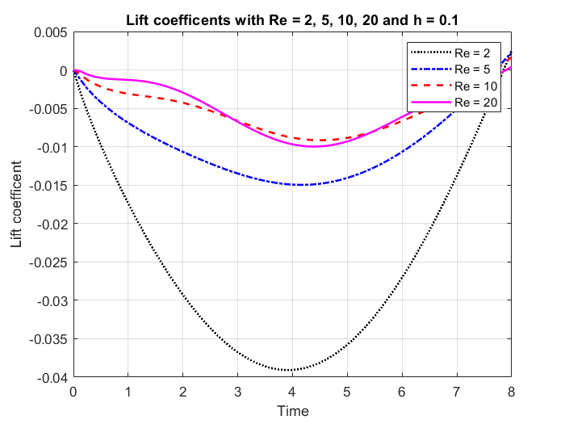
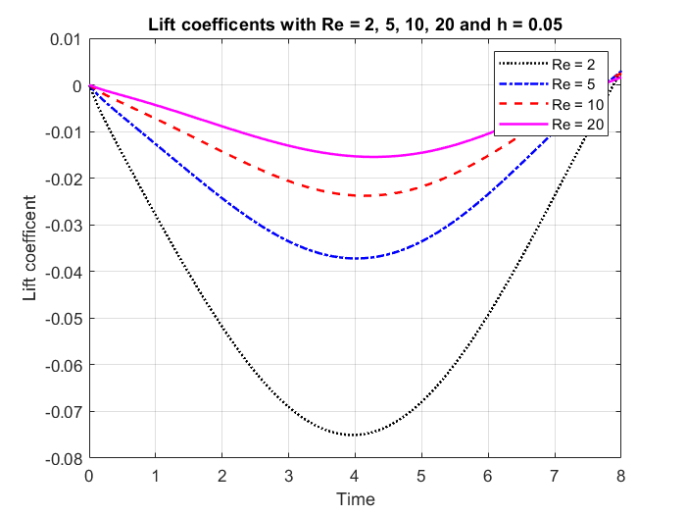

Slide 23
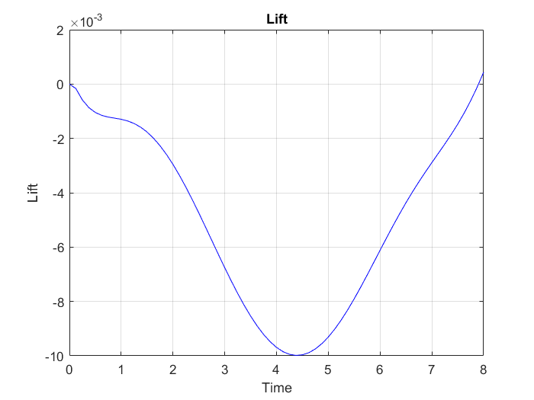
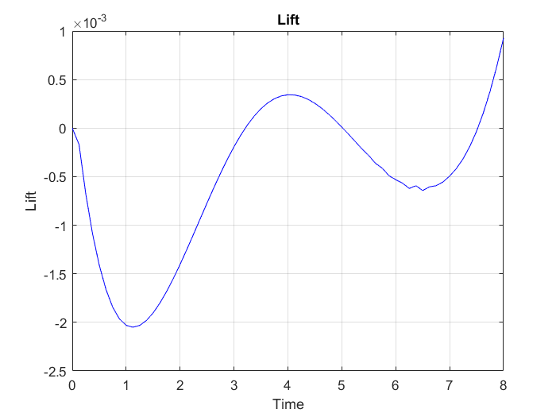
SKREW SYMMETRIC
Dt = 0,125, h = 0.1
CONVECTIVE FORM
RE | C.F | S.S.F
2 | 592.6 s | 681.8 s
5 | 1095 s | 1394 s
10 | 1720 s | 1347 s
20 | 3083 s | 1882 s
Re = 20
SKREW SYMMETRIC

Slide 24
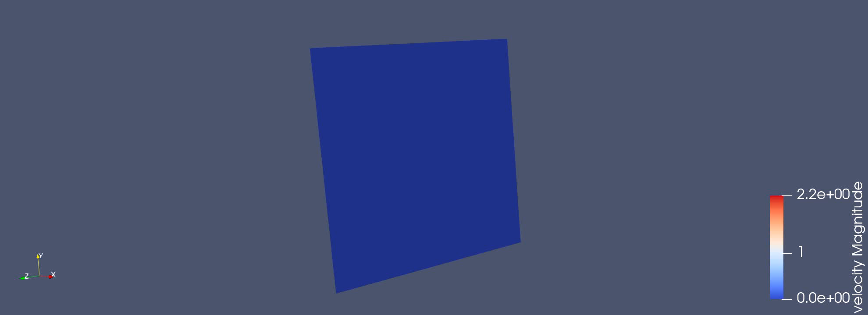
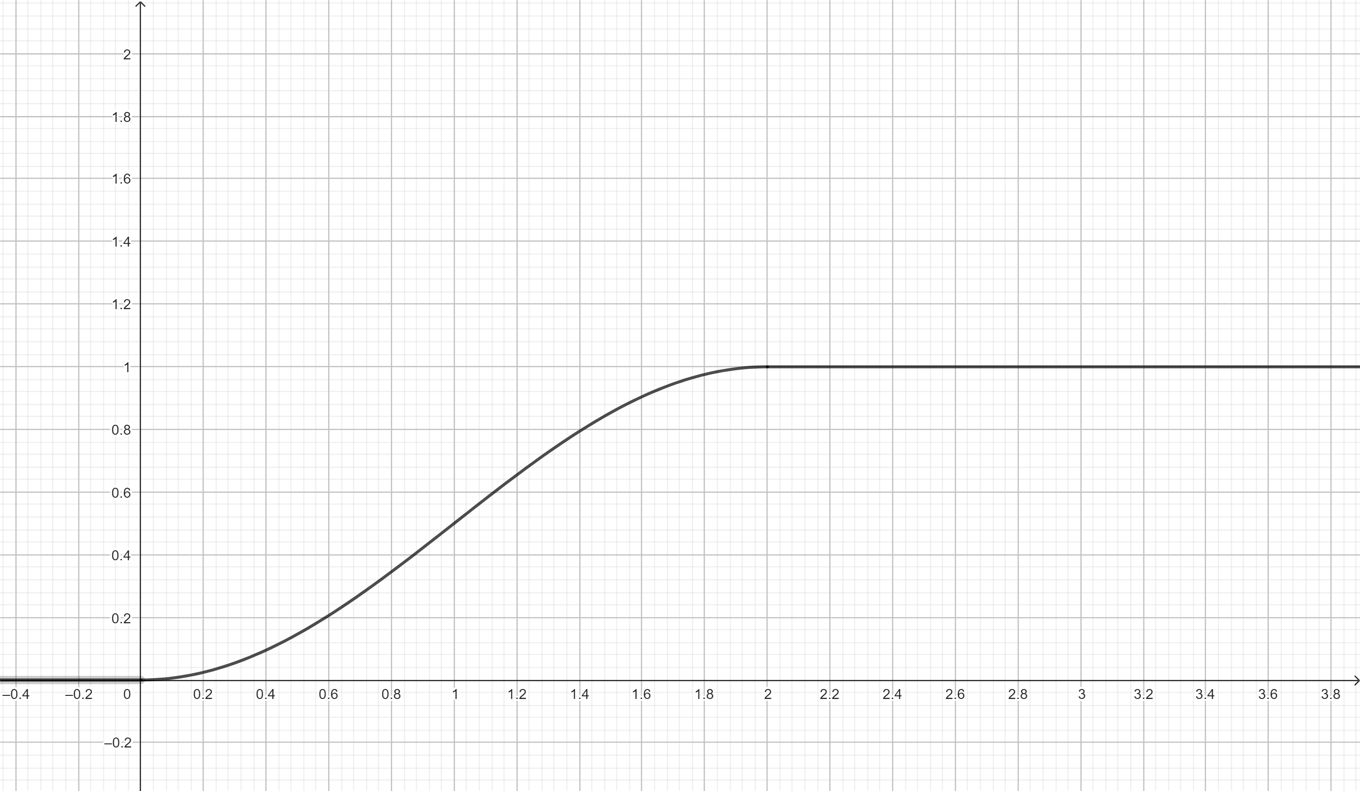
RAMP VELOCITY
$$U\left(0, y, z\right)=\frac{16U_{m}yz\left(H −y\right)\left(H−z\right)[0.5\left(1−\cos\left(\frac{πt}{2}\right)\right)]}{H^{4}}$$

Slide 25
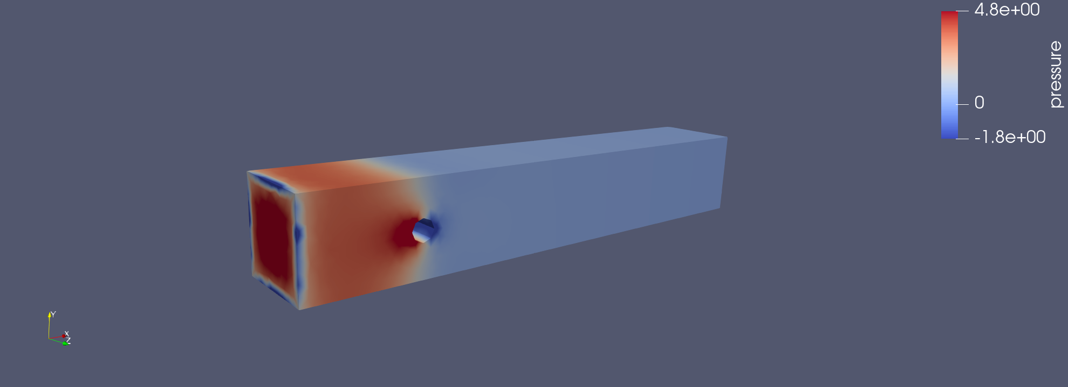
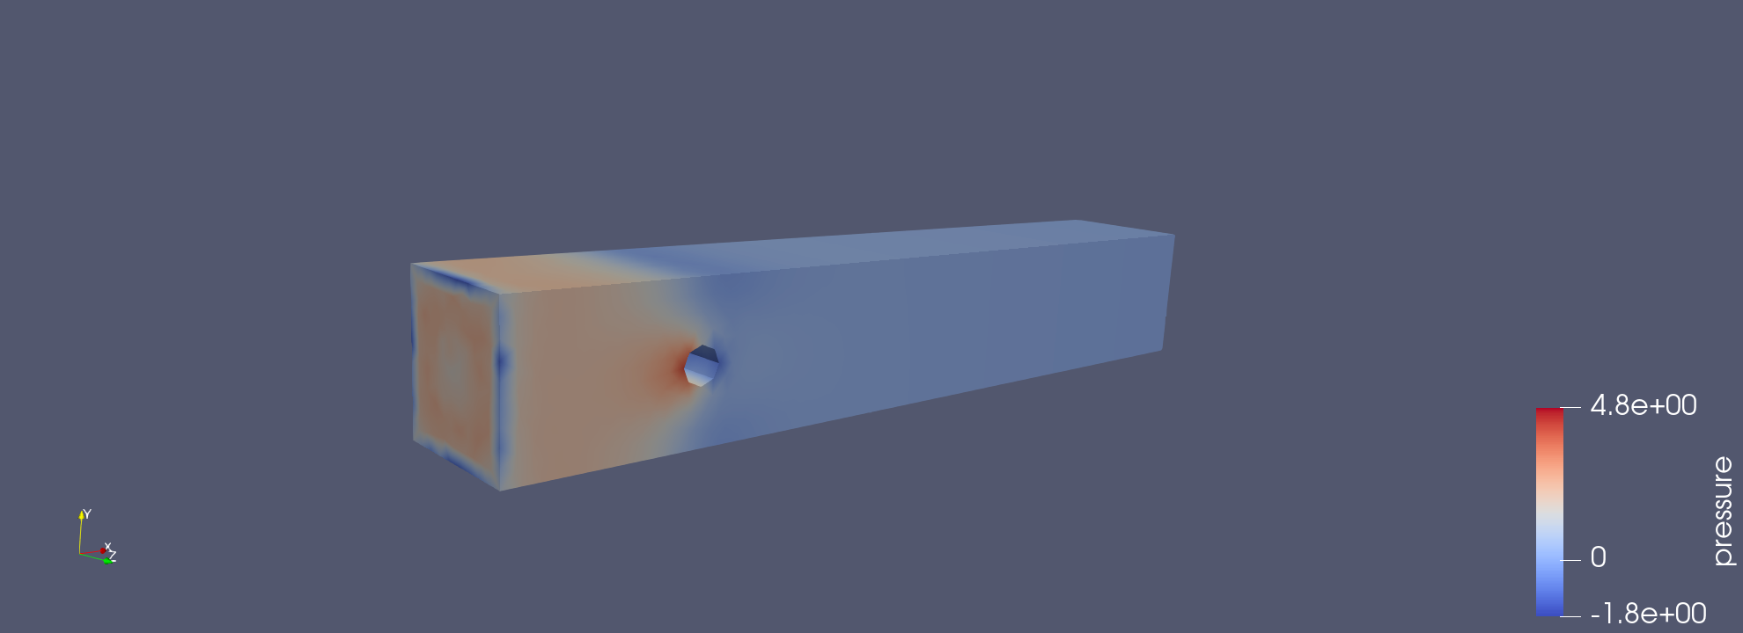
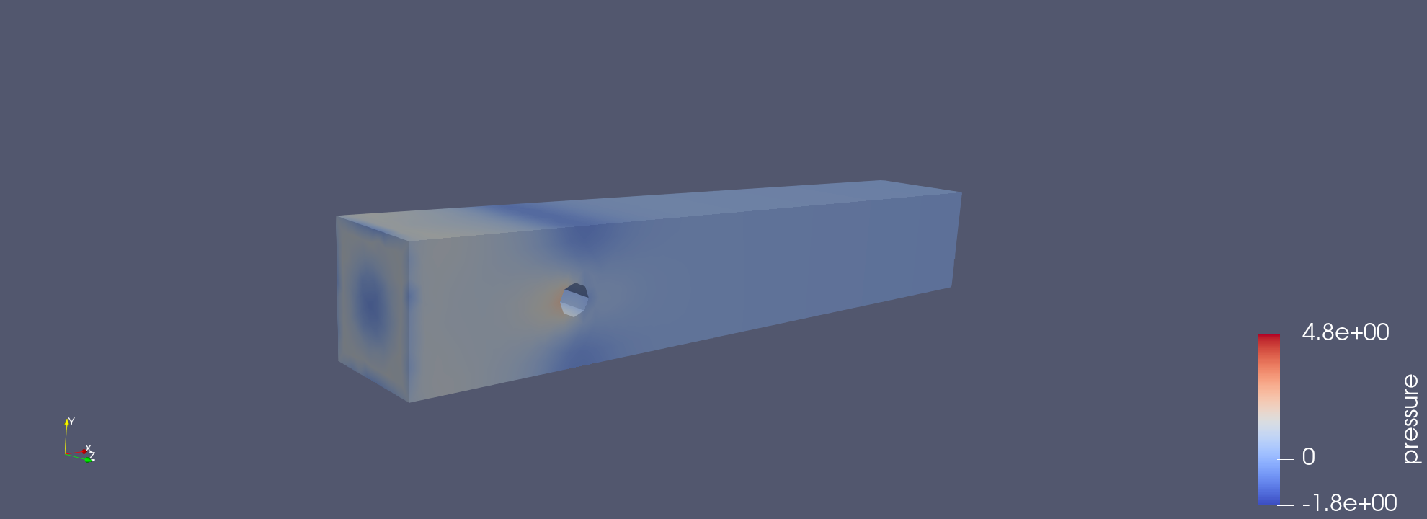
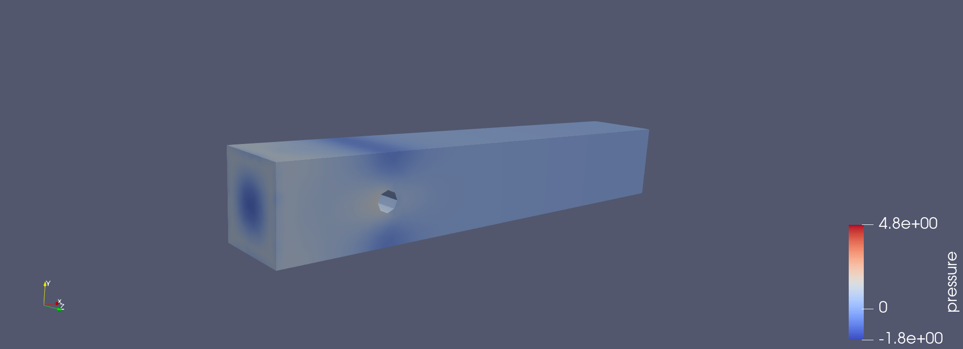
PRESSURE (h = 0.05, dt = 0.125, t=2.0)
Re = 1
Re = 2
Re = 5
Re = 10

Slide 26
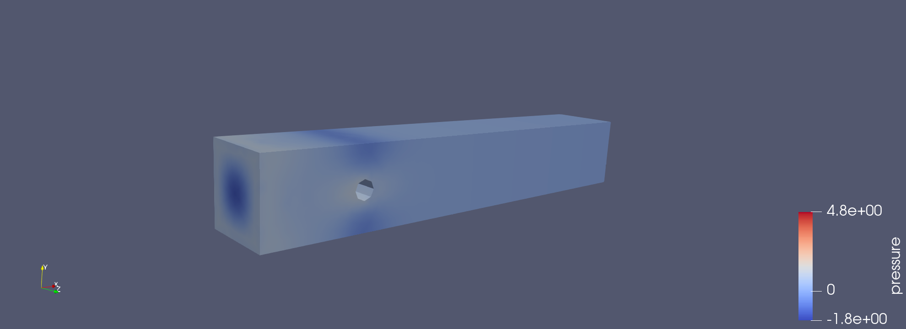
RE = 20

Slide 27

VELOCITY (h = 0.05, dt = 0.125, Re=20, t = 2.0)

Slide 28


Time vs Reynolds for different meshes($∆t$ = 0.125)

Slide 29


DRAG AND LIFT COMPARISON (h = 0.05, dt = 0.125)

Slide 30

PRECONDITIONERS
Preconditioner | Ramp (s) | Sinusoidal (s)
Identity | 441,7 | 472
Block Diagonal | 225,7 | 288,5
Block Triangular | / | 120
Parameters:
$R$e = 0.6
$$μ=0.05$$
$$ρ =0.3$$
h = 0.1
dt = 0.125

Slide 31




Pressure Convection–Diffusion preconditioner
$$∆t$$ | PCD (Residual)
$${10}^{−1}$$ | 9.38636e-2
$${10}^{−2}$$ | 8.54078e-04
$${10}^{−3}$$ | 8.75927e-06
$${10}^{−4}$$ | 9.45825e-08

